Slide 1

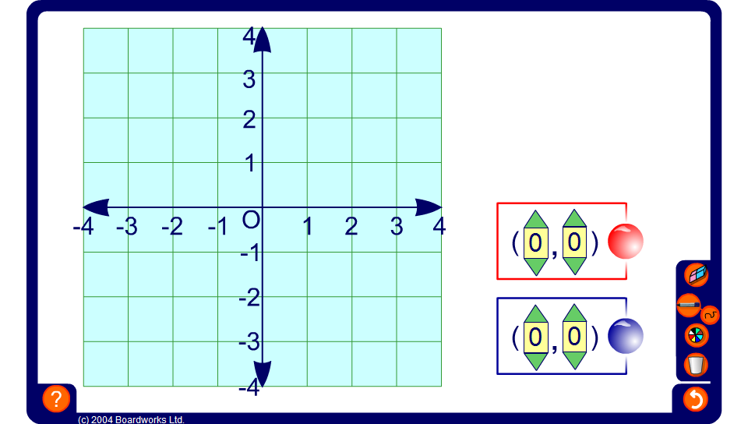


Don’t connect three!
Notes:
The object of this game is to place counters on the grid without getting three in a row horizontally, vertically, or diagonally.
Divide the group into two teams, red and blue. Decide who will start and take alternate turns. The game gets more difficult as the grid fills up.
Make the game more challenging by only allowing teams to change one of their coordinates each turn (either the x- or the y-coordinate).

